Slide 1
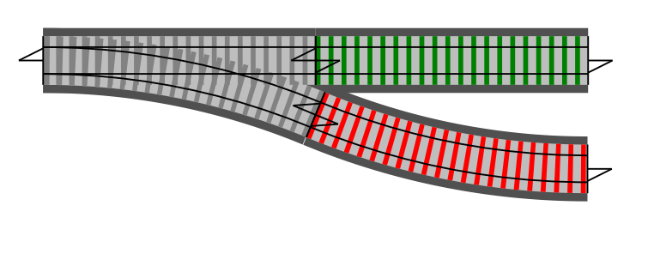
Railway Oriented Programming A functional approach to error handling
What do railways have to do with programming?

Slide 2
Railway Oriented Programming A functional approach to error handling
Scott Wlaschin
@ScottWlaschin
fsharpforfunandprofit.com
Examples will be in F#...
...but OCaml and Haskell are very similar.

Slide 3
Overview
Topics covered:
Happy path programming
Straying from the happy path
Introducing "Railway Oriented Programming"
Railway oriented programming in practice
Extending the framework

Slide 4

Happy path programming
Implementing a simple use case

Slide 5
A simple use case
"As a user I want to update my name and email address"
Receive request
type Request = { userId: int; name: string; email: string }
Validate and canonicalize request
Update existing user record
Send verification email
Return result to user

Slide 6
Imperative code
string UpdateCustomer()
{
var request = receiveRequest();
validateRequest(request);
canonicalizeEmail(request);
db.updateDbFromRequest(request);
smtpServer.sendEmail(request.Email);
return "Success";
}

Slide 7
Functional flow
let updateCustomer =
receiveRequest
>> validateRequest
>> canonicalizeEmail
>> updateDbFromRequest
>> sendEmail
>> returnMessage
F# left-to-right composition operator

Slide 8
Straying from the happy path...
What do you do when something goes wrong?

Slide 9
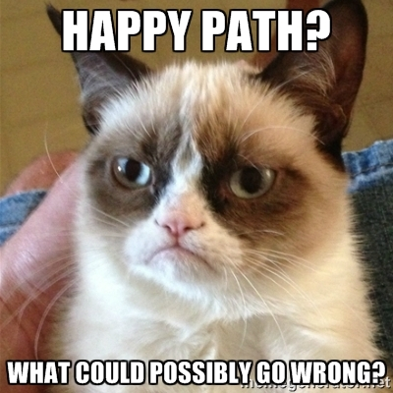
Straying from the happy path

Slide 10
“A program is a spell cast over a computer, turning input into error messages”

Slide 11
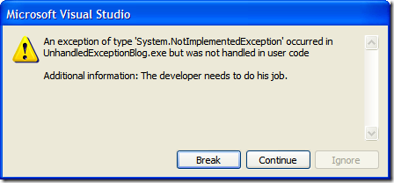
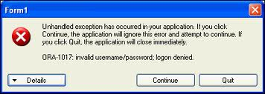
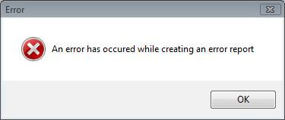
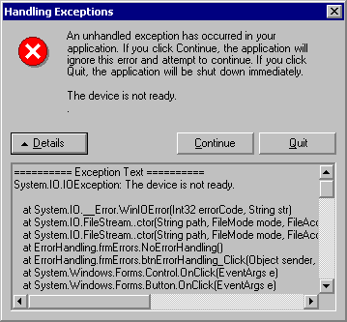
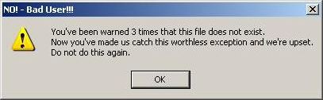
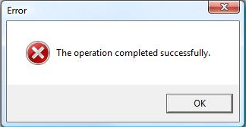
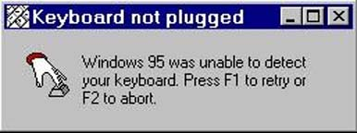
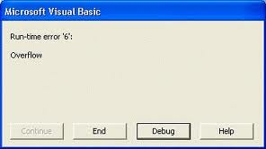
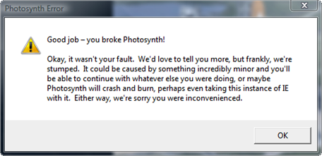
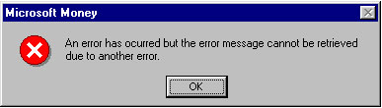

Slide 12

Straying from the happy path
"As a user I want to update my name and email address"
- and see sensible error messages when something goes wrong!
Receive request
type Request = { userId: int; name: string; email: string }
Validate and canonicalize request
Name is blank Email not valid
Update existing user record
User not found Db error
Send verification email
Authorization error Timeout
Return result to user

Slide 13
Imperative code with error handling
string UpdateCustomerWithErrorHandling()
{
var request = receiveRequest();
validateRequest(request);
canonicalizeEmail(request);
db.updateDbFromRequest(request);
smtpServer.sendEmail(request.Email)
return "OK";
}

Slide 14
Imperative code with error handling
string UpdateCustomerWithErrorHandling()
{
var request = receiveRequest();
var isValidated = validateRequest(request);
if (!isValidated) {
return "Request is not valid"
}
canonicalizeEmail(request);
db.updateDbFromRequest(request);
smtpServer.sendEmail(request.Email)
return "OK";
}

Slide 15
Imperative code with error handling
string UpdateCustomerWithErrorHandling()
{
var request = receiveRequest();
var isValidated = validateRequest(request);
if (!isValidated) {
return "Request is not valid"
}
canonicalizeEmail(request);
var result = db.updateDbFromRequest(request);
if (!result) {
return "Customer record not found"
}
smtpServer.sendEmail(request.Email)
return "OK";
}

Slide 16
Imperative code with error handling
string UpdateCustomerWithErrorHandling()
{
var request = receiveRequest();
var isValidated = validateRequest(request);
if (!isValidated) {
return "Request is not valid"
}
canonicalizeEmail(request);
try {
var result = db.updateDbFromRequest(request);
if (!result) {
return "Customer record not found"
}
} catch {
return "DB error: Customer record not updated"
}
smtpServer.sendEmail(request.Email)
return "OK";
}

Slide 17
Imperative code with error handling
string UpdateCustomerWithErrorHandling()
{
var request = receiveRequest();
var isValidated = validateRequest(request);
if (!isValidated) {
return "Request is not valid"
}
canonicalizeEmail(request);
try {
var result = db.updateDbFromRequest(request);
if (!result) {
return "Customer record not found"
}
} catch {
return "DB error: Customer record not updated"
}
if (!smtpServer.sendEmail(request.Email)) {
log.Error "Customer email not sent"
}
return "OK";
}

Slide 18
Imperative code with error handling
string UpdateCustomerWithErrorHandling()
{
var request = receiveRequest();
var isValidated = validateRequest(request);
if (!isValidated) {
return "Request is not valid"
}
canonicalizeEmail(request);
try {
var result = db.updateDbFromRequest(request);
if (!result) {
return "Customer record not found"
}
} catch {
return "DB error: Customer record not updated"
}
if (!smtpServer.sendEmail(request.Email)) {
log.Error "Customer email not sent"
}
return "OK";
}
Q: What is the functional equivalent of this code?
... and can we preserve the elegance of the original functional version?
6 clean lines -> 18 ugly lines. 200% extra! Sadly this is typical of error handling code.

Slide 19
Functional flow with error handling
Before
let updateCustomer =
receiveRequest
>> validateRequest
>> canonicalizeEmail
>> updateDbFromRequest
>> sendEmail
>> returnMessage
Q: What is the functional equivalent of this code?
... and can we preserve the elegance of the original functional version?

Slide 20
Functional flow with error handling
Does this look familiar?
After
let updateCustomerWithErrorHandling =
receiveRequest
>> validateRequest
>> canonicalizeEmail
>> updateDbFromRequest
>> sendEmail
>> returnMessage
Don't believe me? Stay tuned!
Q: What is the functional equivalent of this code?
... and can we preserve the elegance of the original functional version?

Slide 21
Designing the unhappy path

Slide 22
Request/response (non-functional) design
Request handling service
Request
Validate
Update
Send
Response
Request handling service
Happy path – without errors
Request
Validate
Update
Send
Response
Request handling service
Request
Validate
Update
Send
Unhappy path – with errors
Errors
Response
Imperative code can return early

Slide 23
Data flow (functional) design
Request
A single function representing the use case
Validate
Update
Send
Response
A single function representing the use case
Request
Validate
Update
Send
Response
Happy path – without errors
A single function representing the use case
Request
Validate
Update
Send
Success Response
Errors
Error Response
Q: How can a function have more than one output?
Q: How can you bypass downstream functions when an error happens?

Slide 24
What about using exceptions?
"[Exception handling] takes simple, reproducible and easy to diagnose failures and turns them into hard-to-debug subtle corruptions"
-- Larry Osterman
"It's impossible to write reliable software that uses exceptions for error propagation.
Exceptions only really work reliably when nobody catches them."
-- Michael Grier
Both quotes from http://blogs.msdn.com/b/larryosterman/archive/2004/09/10/228068.aspx

Slide 25
Functional design
A single function representing the use case
Request
Validate
Update
Send
Success
Errors
Failure
How can a function have more than one output?
type Result =
| Success
| ValidationError
| UpdateError
| SmtpError
I love sum types!
But maybe too specific for this case?

Slide 26
Functional design
A single function representing the use case
Request
Validate
Update
Send
Success
Errors
Failure
How can a function have more than one output?
type Result =
| Success
| Failure
Much more generic – but no data!

Slide 27
Functional design
A single function representing the use case
Request
Validate
Update
Send
Success
Errors
Failure
How can a function have more than one output?
type Result<'TEntity> =
| Success of 'TEntity
| Failure of string
Good for now – we'll revisit this design later.

Slide 28
Functional design
A single function representing the use case
Request
Validate
Update
Send
Success
Errors
Failure
Each use case will be equivalent to a single function
The function will return a sum type with two cases: "Success" and "Failure".
The use case function will be built from a series of smaller functions, each representing one step in a data flow.
The errors from each step will be combined into a single "failure" path.
But we haven't answered the question: How can you bypass downstream functions when an error happens?

Slide 29
How do I work with errors in a functional way?

Slide 30
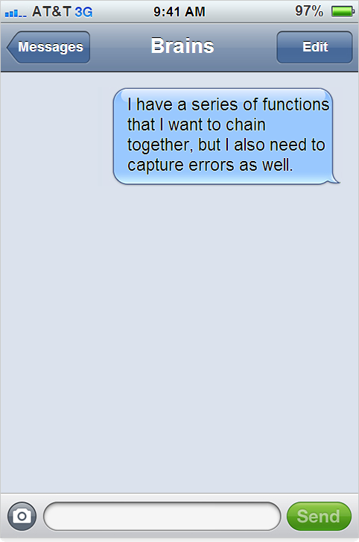


Monad dialog
Very clever
A bear of very little brain

Slide 31
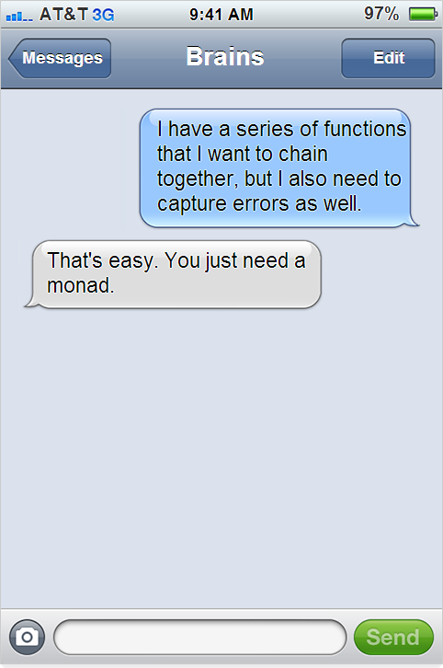

Slide 32
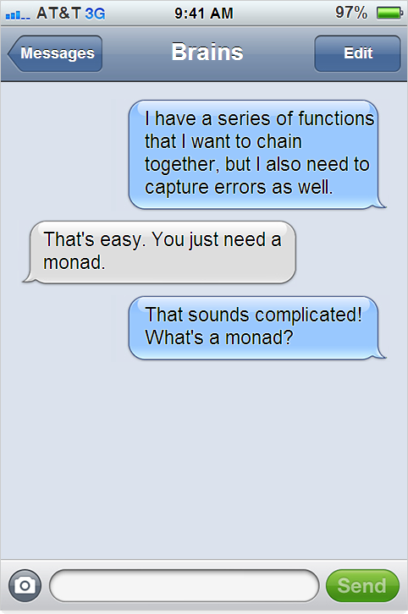

Slide 33
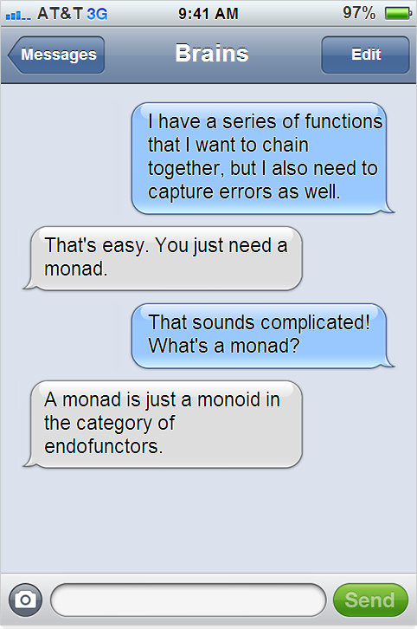

Slide 34
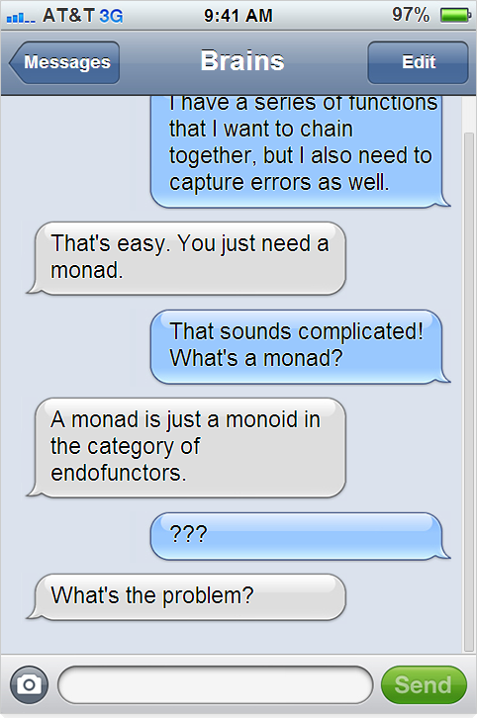

Slide 35
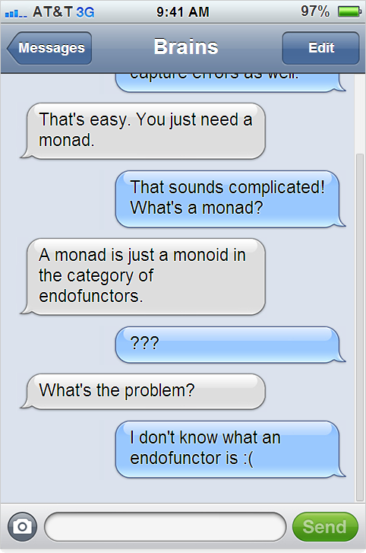

Slide 36
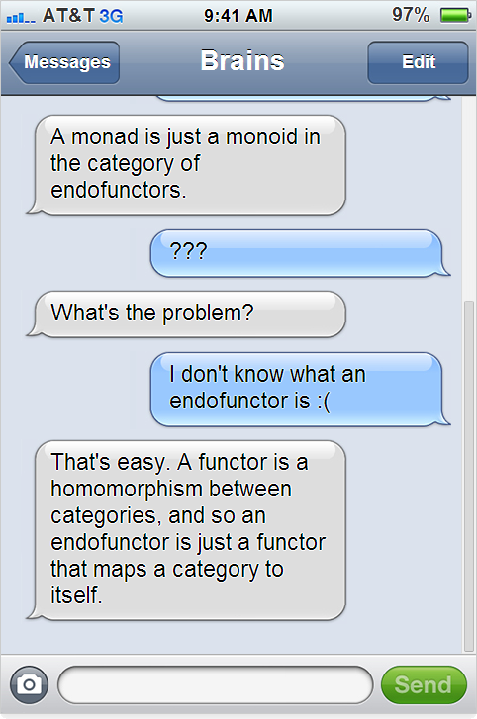

Slide 37
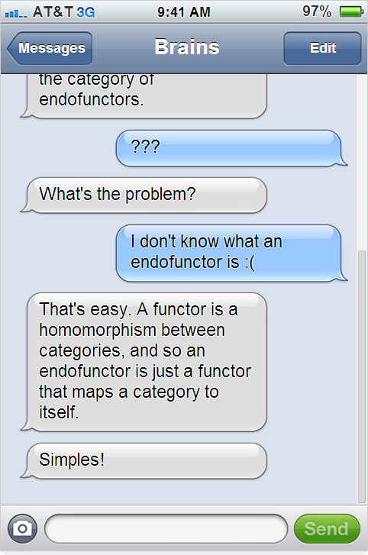

Slide 38
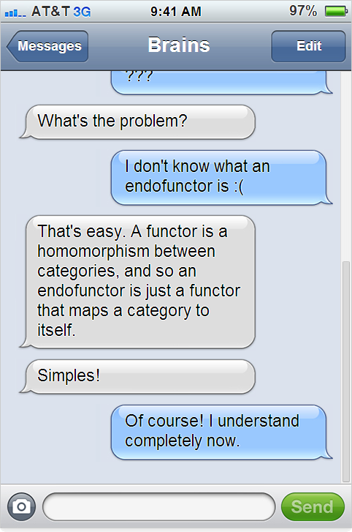

Slide 39
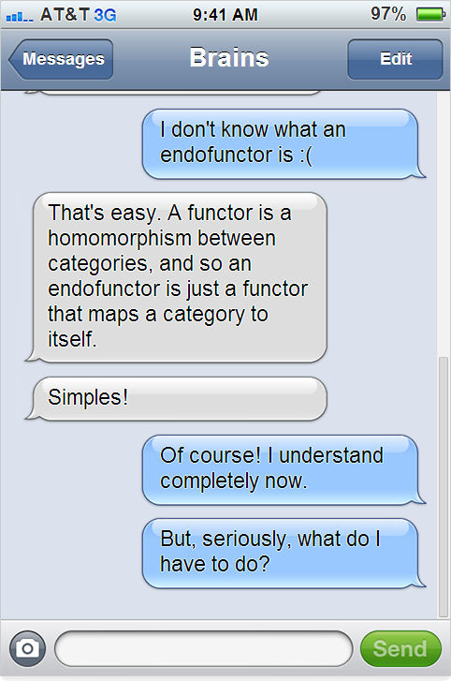

Slide 40
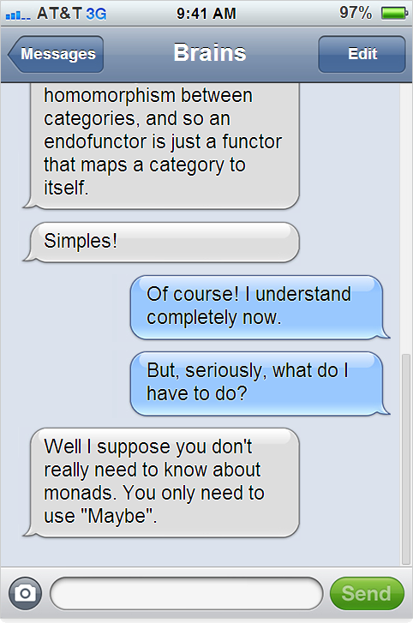

Slide 41
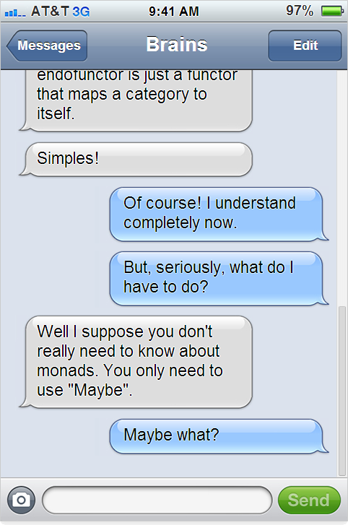

Slide 42
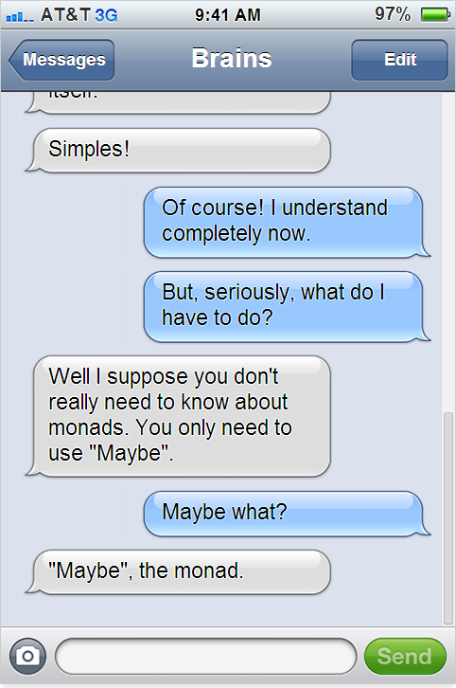

Slide 43
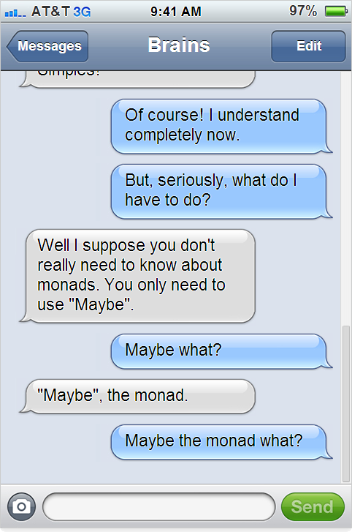

Slide 44
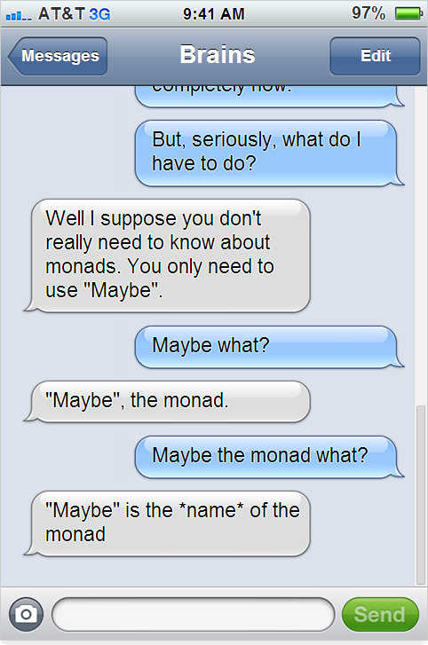

Slide 45
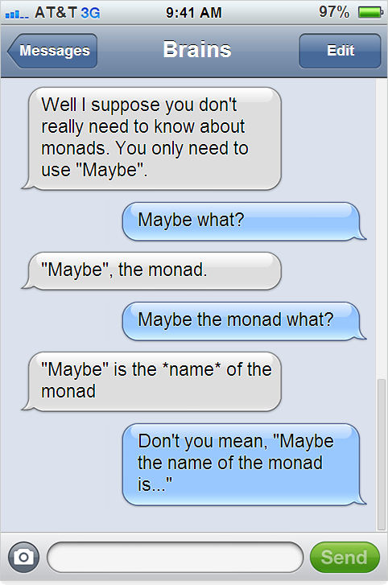

Slide 46
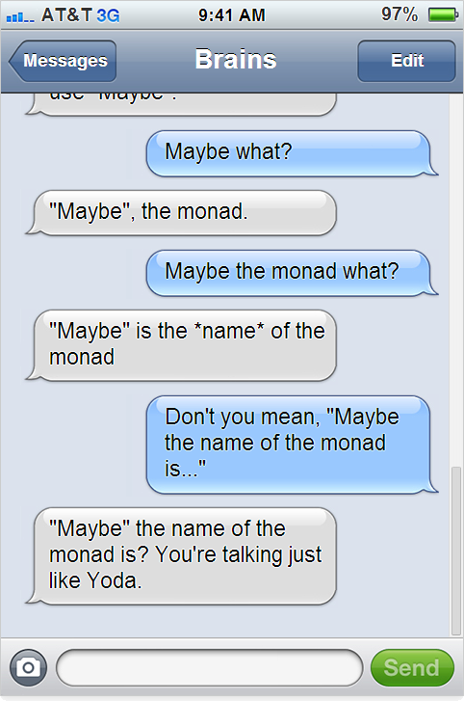

Slide 47
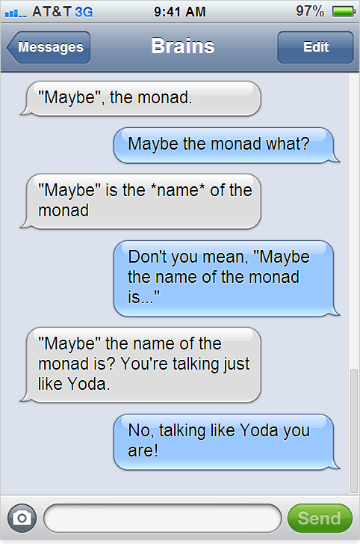

Slide 48
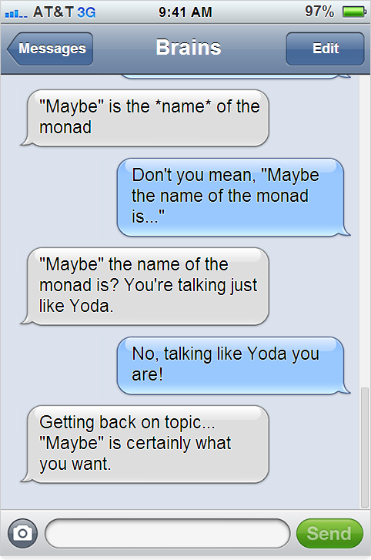

Slide 49
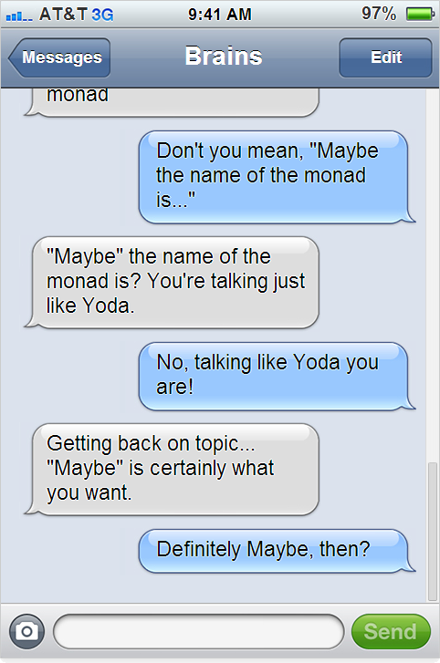
v

Slide 50
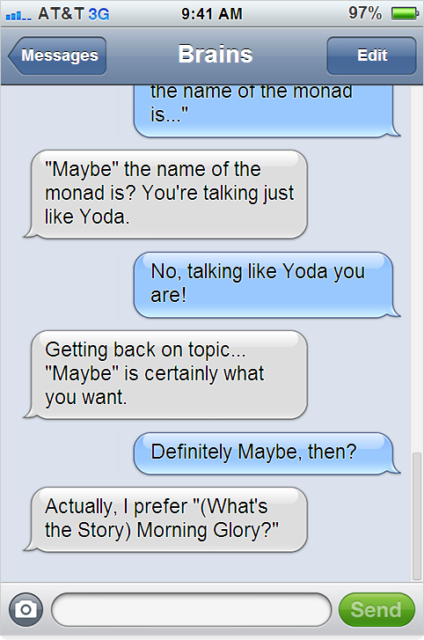

Slide 51
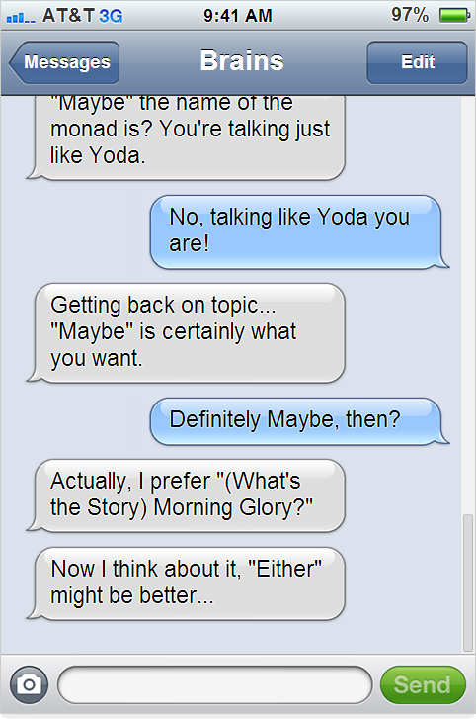

Slide 52
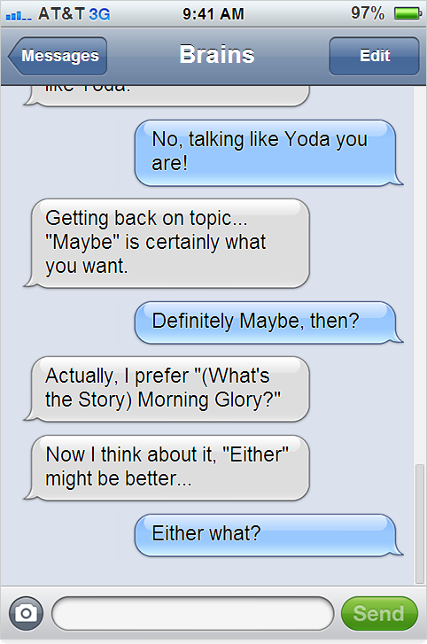

Slide 53
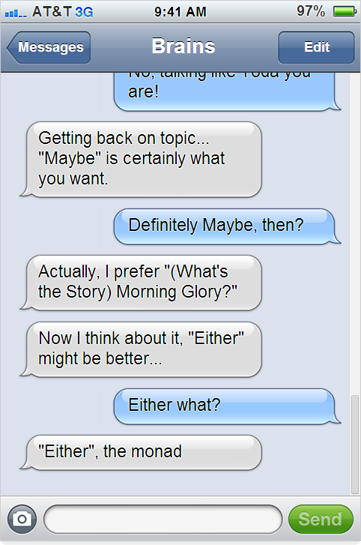

Slide 54
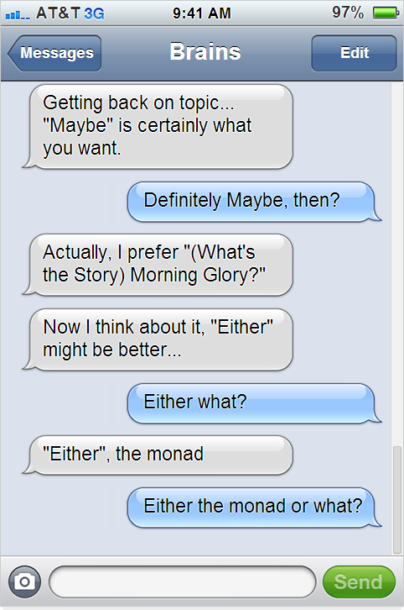

Slide 55
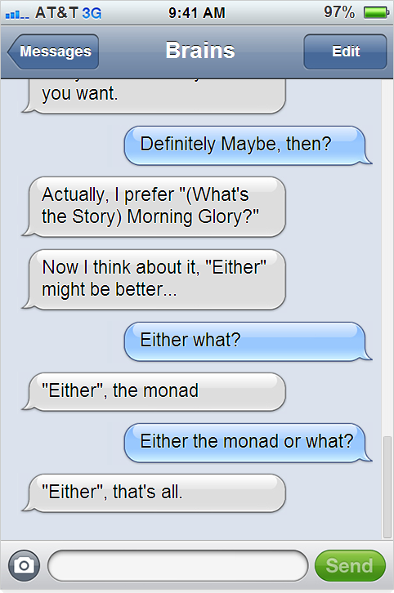

Slide 56
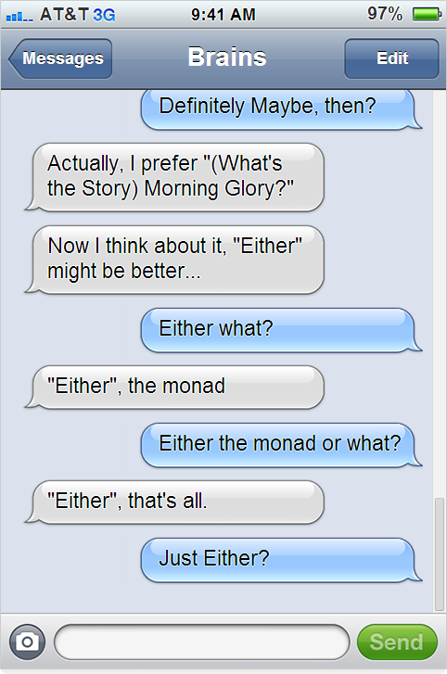

Slide 57
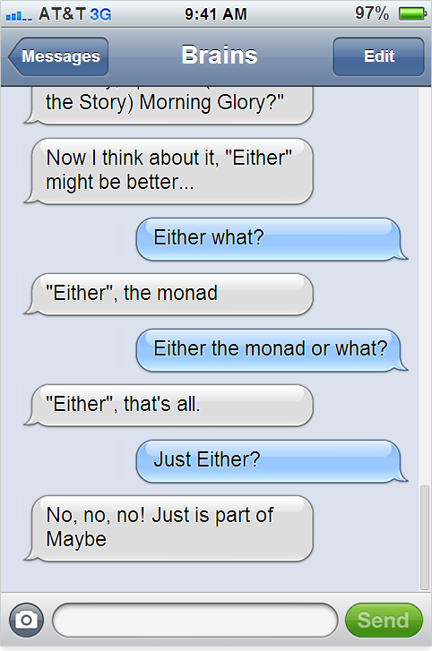

Slide 58
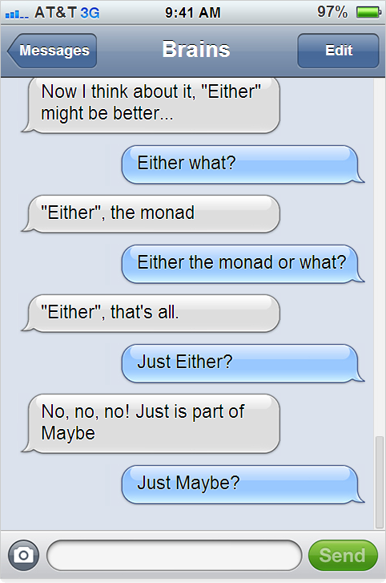

Slide 59
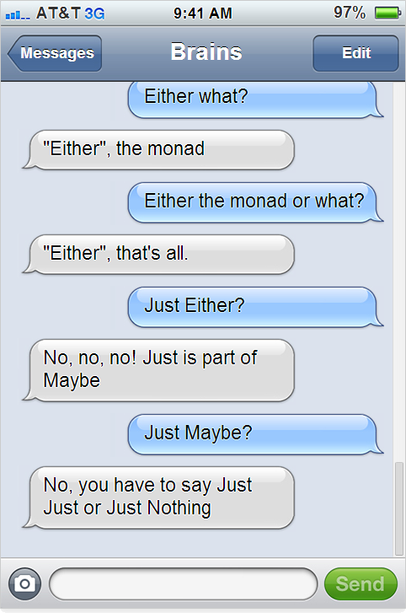

Slide 60
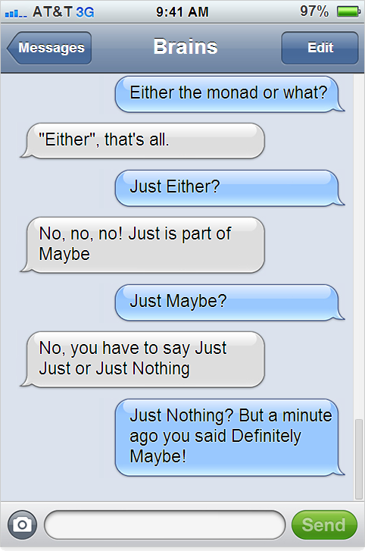

Slide 61
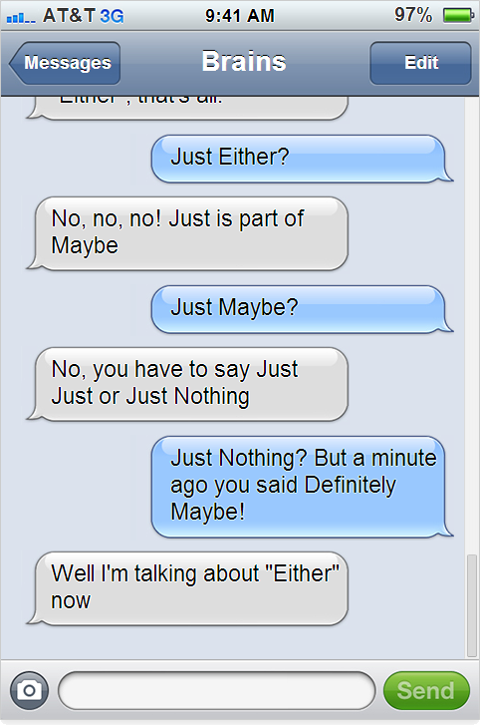

Slide 62
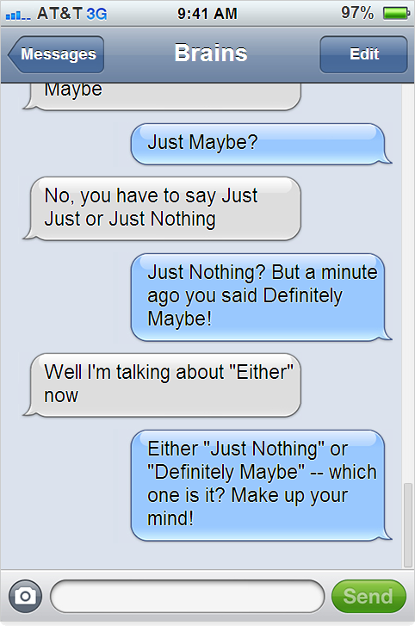

Slide 63
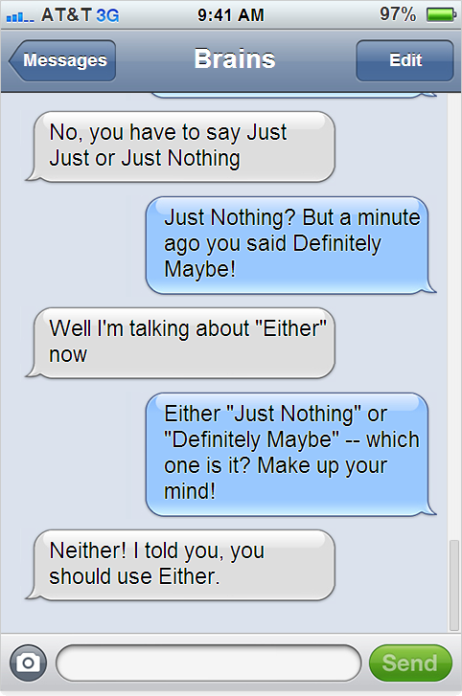

Slide 64
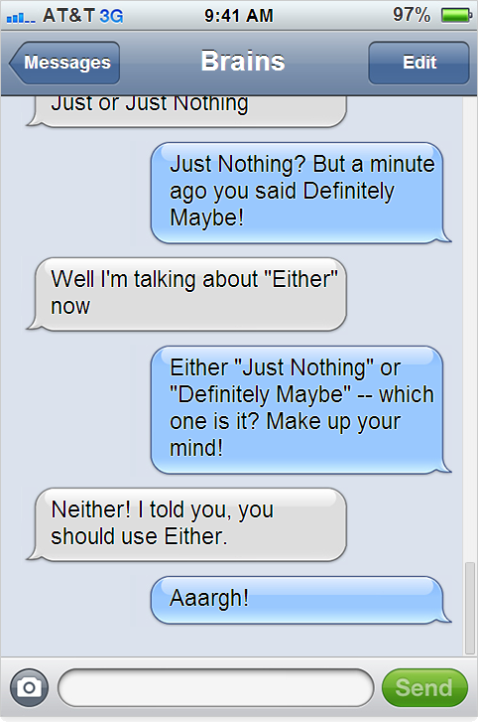

Slide 65
Monads are confusing?
Monads are not really that confusing
http://bit.ly/monad-paper
Read the original paper.

Slide 66
Railway oriented programming
This has absolutely nothing to do with monads.

Slide 67
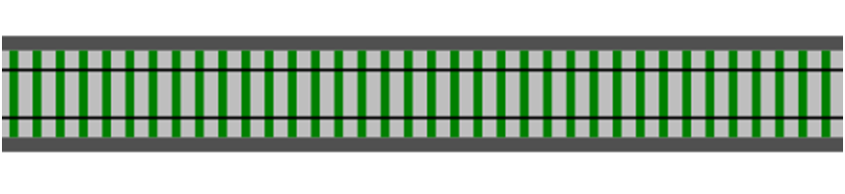


A railway track analogy
The Tunnel of Transformation
Function apple -> banana

Slide 68
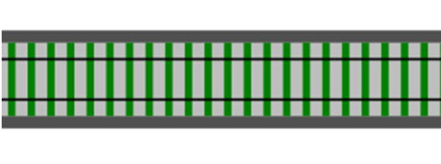


A railway track analogy
Function 1 apple -> banana
Function 2 banana -> cherry

Slide 69
A railway track analogy
Function 1 apple -> banana
Function 2 banana -> cherry
>>
Composition

Slide 70
A railway track analogy
New function
New Function apple -> cherry
Can't tell it was built from smaller functions!

Slide 71
An error generating function
Request
Validate
Success
Failure
How do we model this as railway track?
let validateInput input =
if input.name = "" then
Failure "Name must not be blank"
else if input.email = "" then
Failure "Email must not be blank"
else
Success input // happy path

Slide 72
Introducing switches
Input ->
Success!
Failure

Slide 73
Connecting switches
Validate
on success
UpdateDb
bypass

Slide 74
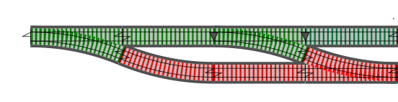
Connecting switches
Validate
UpdateDb

Slide 75
Connecting switches
Validate
UpdateDb
SendEmail

Slide 76

Connecting switches
Validate
UpdateDb
SendEmail
This is the "two track" model – the basis for the "Railway Oriented Programming" approach to error handling.

Slide 77
The two-track model in practice

Slide 78
Composing switches
Validate
UpdateDb
SendEmail
Here we have a series of black box functions that are straddling a two-track railway.

Slide 79
Composing switches
Validate
UpdateDb
SendEmail
Here we have a series of black box functions that are straddling a two-track railway.
Inside each box there is a switch function.

Slide 80

Composing switches
Validate
UpdateDb
SendEmail
>>
>>
Composing one-track functions is fine...

Slide 81

Composing switches
Validate
UpdateDb
SendEmail
>>
>>
... and composing two-track functions is fine...

Slide 82
Composing switches
Validate
UpdateDb
SendEmail
✗
✗
... but composing switches is not allowed!

Slide 83

Composing switches
✗
One-track input
Validate
Two-track input
Before: Not suitable for composition
✓
Validate
Two-track input
Two-track input
So how can we convert from the "before" case to the "after" case?
After: Suitable for composition

Slide 84

Building an adapter block
Two-track input
Two-track output
Slot for switch function

Slide 85
Building an adapter block
Two-track input
Two-track output
Validate
Validate

Slide 86
Building an adapter block
Two-track input
Two-track output
let adapt switchFunction =
fun twoTrackInput ->
match twoTrackInput with
| Success s -> switchFunction s
| Failure f -> Failure f

Slide 87
Building an adapter block
Two-track input
Two-track output
let adapt switchFunction =
fun twoTrackInput ->
match twoTrackInput with
| Success s -> switchFunction s
| Failure f -> Failure f

Slide 88
Building an adapter block
Two-track input
Two-track output
let adapt switchFunction =
fun twoTrackInput ->
match twoTrackInput with
| Success s -> switchFunction s
| Failure f -> Failure f

Slide 89
Building an adapter block
Two-track input
Two-track output
let adapt switchFunction =
fun twoTrackInput ->
match twoTrackInput with
| Success s -> switchFunction s
| Failure f -> Failure f

Slide 90
Bind as an adapter block
Two-track input
Two-track output
let bind switchFunction =
fun twoTrackInput ->
match twoTrackInput with
| Success s -> switchFunction s
| Failure f -> Failure f
bind : ('a -> TwoTrack<'b>) -> TwoTrack<'a> -> TwoTrack<'b>
Switch function
2-track input
2-track output

Slide 91
Bind as an adapter block
Two-track input
Two-track output
let bind switchFunction twoTrackInput =
match twoTrackInput with
| Success s -> switchFunction s
| Failure f -> Failure f
Same function: alternative version with two parameters.
bind : ('a -> TwoTrack<'b>) -> TwoTrack<'a> -> TwoTrack<'b>
Switch function
2-track input
2-track output

Slide 92
Bind example
nameNotBlank
let nameNotBlank input =
if input.name = "" then
Failure "Name must not be blank"
else Success input
let name50 input =
if input.name.Length > 50 then
Failure "Name must not be longer than 50 chars"
else Success input
let emailNotBlank input =
if input.email = "" then
Failure "Email must not be blank"
else Success input
name50
emailNotBlank

Slide 93
Bind example
nameNotBlank
name50
emailNotBlank
nameNotBlank (combined with)
name50 (combined with)
emailNotBlank

Slide 94
Bind example
nameNotBlank
name50
emailNotBlank
bind nameNotBlank
bind name50
bind emailNotBlank
use "bind" to convert to 2-track

Slide 95
Bind example
nameNotBlank
name50
emailNotBlank
bind nameNotBlank
>> bind name50
>> bind emailNotBlank
then compose together

Slide 96
Bind example
validateRequest
let validateRequest =
bind nameNotBlank
>> bind name50
>> bind emailNotBlank
// validateRequest : TwoTrack<Request> -> TwoTrack<Request>
Define a function
Overall result is a new two-track function

Slide 97
Bind example
validateRequest
Common symbol for bind
let (>>=) twoTrackInput switchFunction =
bind switchFunction twoTrackInput
let validateRequest twoTrackInput =
twoTrackInput
>>= nameNotBlank
>>= name50
>>= emailNotBlank
Needs a explicit parameter
Bind symbol = F# composition symbol + railway track symbol! Coincidence?

Slide 98
Bind doesn't stop transformations
Note that bind is about shape. Transformations can still happen.
FunctionA
FunctionB
TEntity = Apple
TEntity = Banana
TEntity = Cherry
type TwoTrack<'TEntity> =
| Success of 'TEntity
| Failure of string

Slide 99
Composing switches - review
Validate
UpdateDb
SendEmail
Converted to two-track functions using bind
Validate
UpdateDb
SendEmail

Slide 100

Comic Interlude
What do you call a train that eats toffee?
I don't know, what do you call a train that eats toffee?
A chew, chew train!

Slide 101
More fun with railway tracks...
Working with other functions

Slide 102
More fun with railway tracks...
Fitting other functions into this framework:
Single track functions
Dead-end functions
Functions that throw exceptions
Supervisory functions

Slide 103
Converting one-track functions
Fitting other functions into this framework:
Single track functions
Dead-end functions
Functions that throw exceptions
Supervisory functions

Slide 104
Converting one-track functions
canonicalizeEmail
// trim spaces and lowercase
let canonicalizeEmail input =
{ input with email = input.email.Trim().ToLower() }
A simple function that doesn't generate errors – a "one-track" function.

Slide 105
Converting one-track functions
canonicalizeEmail
Validate
UpdateDb
SendEmail
✗
Won't compose

Slide 106

Converting one-track functions
Two-track input
Two-track output
Slot for one-track function

Slide 107


Converting one-track functions
Two-track input
Two-track output
Canonicalize
Canonicalize

Slide 108
Converting one-track functions
Two-track input
Two-track output
let map singleTrackFunction twoTrackInput =
fun twoTrackInput -> match twoTrackInput with
| Success s -> Success (singleTrackFunction s)
| Failure f -> Failure f
map : ('a -> 'b) -> TwoTrack<'a> -> TwoTrack<'b>`
Single track function
2-track input
2-track output

Slide 109
Converting one-track functions
Two-track input
Two-track output
let map singleTrackFunction =
bind (singleTrackFunction >> Success)
Tip: "map" can also be built from "bind" and "Success"
map : ('a -> 'b) -> TwoTrack<'a> -> TwoTrack<'b>
Single track function
2-track input
2-track output

Slide 110
Converting one-track functions
canonicalizeEmail
Validate
UpdateDb
SendEmail
✓
Will compose

Slide 111
Converting dead-end functions
Fitting other functions into this framework:
Single track functions
Dead-end functions
Functions that throw exceptions
Supervisory functions

Slide 112

Converting dead-end functions
updateDb
No output
let updateDb request =
// do something
// return nothing at all
A function that doesn't return anything– a "dead-end" function.

Slide 113

Converting dead-end functions
Validate
UpdateDb
SendEmail
✗
Won't compose

Slide 114

Converting dead-end functions
One-track input
One-track output
Slot for dead end function

Slide 115
Converting dead-end functions
One-track input
One-track output
let tee deadEndFunction oneTrackInput =
deadEndFunction oneTrackInput
oneTrackInput
tee : ('a -> unit) -> 'a -> 'a
Dead end function
one-track input
one-track output

Slide 116

Converting dead-end functions
UpdateDb
Validate
SendEmail
✓
Will compose

Slide 117
Functions that throw exceptions
Fitting other functions into this framework:
Single track functions
Dead-end functions
Functions that throw exceptions
Supervisory functions
Especially to wrap an I/O call

Slide 118

Functions that throw exceptions
Add try/catch to handle timeouts, say
One-track input
Two-track output
SendEmail
SendEmail
Looks innocent, but might throw an exception
Don't bother handling all possible exceptions: E.g. FileNotFound, yes. OutOfMemory, no.

Slide 119

Functions that throw exceptions
Guideline: Convert exceptions into Failures
Even Yoda recommends not to use exception handling for control flow:
"Do or do not, there is no try".

Slide 120
Supervisory functions
Fitting other functions into this framework:
Single track functions
Dead-end functions
Functions that throw exceptions
Supervisory functions
For when you need to handle *both* tracks – e.g. tracing, logging, etc.

Slide 121

Supervisory functions
Two-track input
Two-track output
Slot for one-track function for Success case
Slot for one-track function for Failure case

Slide 122
Putting it all together

Slide 123
Putting it all together
Canonicalize
UpdateDb
Validate
SendEmail
Output??
Input
your browser doesn't understand two-track types!

Slide 124

Putting it all together
Canonicalize
UpdateDb
Validate
SendEmail
returnMessage
Input
Output
let returnMessage result =
match result with
| Success obj -> OK obj.ToJson()
| Failure msg -> BadRequest msg

Slide 125
Putting it all together - review
You can fit most functions into this model.
The "two-track" framework is a useful approach for most use-cases.
Not a solution for everything, but a good starting point.

Slide 126
Putting it all together - review
The "two-track" framework is a useful approach for most use-cases.
Let's look at the code -- before and after adding error handling
let updateCustomer =
receiveRequest
>> validateRequest
>> updateDbFromRequest
>> sendEmail
>> returnMessage
let updateCustomer =
receiveRequest
>> validateRequest
>> updateDbFromRequest
>> sendEmail
>> returnMessage
Before – without error handling
After – with error handling
Still clean and elegant

Slide 127
Comic Interlude
Why can't a steam locomotive sit down?
I don't know, why can't a steam locomotive sit down?
Because it has a tender behind!

Slide 128
Extending the framework:
Designing for errors
Parallel tracks
Domain events

Slide 129
Designing for errors
Unhappy paths are requirements too

Slide 130
Designing for errors
let validateInput input =
if input.name = "" then
Failure "Name must not be blank"
else if input.email = "" then
Failure "Email must not be blank"
else
Success input // happy path
type TwoTrack<'TEntity> =
| Success of 'TEntity
| Failure of string
Using strings is not good

Slide 131
Designing for errors
let validateInput input =
if input.name = "" then
Failure NameMustNotBeBlank
else if input.email = "" then
Failure EmailMustNotBeBlank
else
Success input // happy path
type TwoTrack<'TEntity> =
| Success of 'TEntity
| Failure of ErrorMessage
type ErrorMessage =
| NameMustNotBeBlank
| EmailMustNotBeBlank
Special type rather than string

Slide 132
Designing for errors
let validateInput input =
if input.name = "" then
Failure NameMustNotBeBlank
else if input.email = "" then
Failure EmailMustNotBeBlank
else if (input.email doesn't match regex) then
Failure EmailNotValid input.email
else
Success input // happy path
Add invalid email as data
type ErrorMessage =
| NameMustNotBeBlank
| EmailMustNotBeBlank
| EmailNotValid of EmailAddress

Slide 133
Designing for errors
type ErrorMessage =
| NameMustNotBeBlank
| EmailMustNotBeBlank
| EmailNotValid of EmailAddress
// database errors
| UserIdNotValid of UserId
| DbUserNotFoundError of UserId
| DbTimeout of ConnectionString
| DbConcurrencyError
| DbAuthorizationError of ConnectionString * Credentials
// SMTP errors
| SmtpTimeout of SmtpConnection
| SmtpBadRecipient of EmailAddress
Documentation of everything that can go wrong --
And it's type-safe documentation that can't go out of date!
Also triggers important DDD conversations

Slide 134
Designing for errors – service boundaries
Generic database errors
type DbErrorMessage<'PK> =
| PrimaryKeyNotValid of 'PK
| RecordNotFoundError of 'PK
| DbTimeout of ConnectionString * TimeoutMs
| DbConcurrencyError
| DbAuthorizationError of Credentials
Translation function needed at a service boundary
Specific errors for this use-case
type MyUseCaseError =
| NameMustNotBeBlank
| EmailMustNotBeBlank
| EmailNotValid of EmailAddress
// database errors
| UserIdNotValid of UserId
| DbUserNotFoundError of UserId
| DbTimeout of ConnectionString
| DbConcurrencyError
| DbAuthorizationError of Credentials
// SMTP errors
| SmtpTimeout of SmtpConnection
| SmtpBadRecipient of EmailAddress
let dbResultToMyResult dbError =
match dbError with
| DbErrorMessage.PrimaryKeyNotValid id ->
MyUseCaseError.UserIdNotValid id
| DbErrorMessage.RecordNotFoundError id ->
MyUseCaseError.DbUserNotFoundError id
| _ -> // etc

Slide 135
Designing for errors – converting to strings
returnMessage
let returnMessage result =
match result with
| Success _ -> "Success"
| Failure msg -> msg
No longer works – each case must now be explicitly converted to a string

Slide 136
Designing for errors – converting to strings
returnMessage
let returnMessage result =
match result with
| Success _ -> "Success"
| Failure err ->
match err with
| NameMustNotBeBlank -> "Name must not be blank"
| EmailMustNotBeBlank -> "Email must not be blank"
| EmailNotValid (EmailAddress email) ->
sprintf "Email %s is not valid" email
// database errors
| UserIdNotValid (UserId id) ->
sprintf "User id %i is not a valid user id" id
| DbUserNotFoundError (UserId id) ->
sprintf "User id %i was not found in the database" id
| DbTimeout (_,TimeoutMs ms) ->
sprintf "Could not connect to database within %i ms" ms
| DbConcurrencyError ->
sprintf "Another user has modified the record. Please resubmit"
| DbAuthorizationError _ ->
sprintf "You do not have permission to access the database"
// SMTP errors
| SmtpTimeout (_,TimeoutMs ms) ->
sprintf "Could not connect to SMTP server within %i ms" ms
| SmtpBadRecipient (EmailAddress email) ->
sprintf "The email %s is not a valid recipient" email
Each case must be converted to a string – but this is only needed once, and only at the last step.
Different conversions can be used depending on the target. E.g. user messages vs. logging.
All strings are in one place, so translations are easier.
(or use resource file)

Slide 137
Designing for errors - review
Documentation of everything that can go wrong.
type ErrorMessage =
| NameMustNotBeBlank
| EmailMustNotBeBlank
| EmailNotValid of EmailAddress
// database errors
| UserIdNotValid of UserId
| DbUserNotFoundError of UserId
| DbTimeout of ConnectionString
| DbConcurrencyError
| DbAuthorizationError of ConnectionString * Credentials
// SMTP errors
| SmtpTimeout of SmtpConnection
| SmtpBadRecipient of EmailAddress
Type-safe -- can't go out of date!
Surfaces hidden requirements.
Test against error codes, not strings.
Makes translation easier.

Slide 138
Parallel tracks

Slide 139
Parallel validation
nameNotBlank
name50
emailNotBlank
Problem: Validation done in series.
So only one error at a time is returned
It would be nice to return all validation errors at once.

Slide 140
Parallel validation
nameNotBlank
name50
Split input
Combine output
Now we do get all errors at once!
emailNotBlank
... But how to combine?

Slide 141
Combining switches
Trick: if we create an operation that combines pairs into a new switch, we can repeat to combine as many switches as we like.
+

Slide 142
Combining switches
Trick: if we create an operation that combines pairs into a new switch, we can repeat to combine as many switches as we like.
+
+

Slide 143
Combining switches
Trick: if we create an operation that combines pairs into a new switch, we can repeat to combine as many switches as we like.
+
+
-> For more, see "monoids without tears"

Slide 144
Combining switches
+ | Success (S2) | Failure (F2)
Success (S1) | S1 or S2 | F2
Failure (F1) | F1 | [F1; F2]
A failure in either one is a overall failure.

Slide 145
Combining switches
Either input is OK, they are both the same value
+ | Success (S2) | Failure (F2)
Success (S1) | S1 or S2 | F2
Failure (F1) | F1 | [F1; F2]

Slide 146
Combining switches
+ | Success (S2) | Failure (F2)
Success (S1) | S1 or S2 | F2
Failure (F1) | F1 | [F1; F2]
We need to keep both, so store in a list.
type TwoTrack<'TEntity> =
| Success of 'TEntity
| Failure of ErrorMessage list

Slide 147
Combining switches
+ | Success (S2) | Failure (F2)
Success (S1) | S1 or S2 | [F2]
Failure (F1) | [F1] | [F1; F2]
But now these need to be lists too.
type TwoTrack<'TEntity> =
| Success of 'TEntity
| Failure of ErrorMessage list

Slide 148
Handling lists of errors
returnMessage
let errToString err =
match err with
| NameMustNotBeBlank -> "Name must not be blank"
| EmailMustNotBeBlank -> "Email must not be blank"
// etc
let returnMessage result =
match result with
| Success _ -> "Success"
| Failure errs ->
errs
|> List.map errToString
|> List.reduce (fun s1 s2 -> s1 + ";" + s2)
Convert all messages to strings
Collapse a list of strings into a single string

Slide 149
Domain events
Communicating information to downstream functions

Slide 150
Events are not errors
Tell CRM that email was sent
UpdateDb
Validate
SendEmail
Communicate new information to downstream processes without being a failure

Slide 151
Events are not errors
Tell CRM that email was sent
UpdateDb
Validate
SendEmail
type MyUseCaseMessage =
| NameMustNotBeBlank
| EmailMustNotBeBlank
| EmailNotValid of EmailAddress
// database errors
| UserIdNotValid of UserId
// SMTP errors
| SmtpTimeout of SmtpConnection
// Domain events
| UserSaved of AuditInfo
| EmailSent of EmailAddress * MsgId
Communicate new information to downstream processes without being a failure
Add domain events to the choices

Slide 152
Events are not errors
Tell CRM that email was sent
UpdateDb
Validate
SendEmail
type MyUseCaseMessage =
| NameMustNotBeBlank
| EmailMustNotBeBlank
| EmailNotValid of EmailAddress
// database errors
| UserIdNotValid of UserId
// SMTP errors
| SmtpTimeout of SmtpConnection
// Domain events
| UserSaved of AuditInfo
| EmailSent of EmailAddress * MsgId
Communicate new information to downstream processes without being a failure
Add domain events to the choices
Store a list of events (as well as the entity) on the Success path
type TwoTrack<'TEntity> =
| Success of 'TEntity * Message list
| Failure of Message list

Slide 153
Comic Interlude
Why can't a train driver be electrocuted?
I don't know, why can't a train driver be electrocuted?
Because he's not a conductor!

Slide 154
Some topics not covered...
... but could be handled in an obvious way.

Slide 155
Topics not covered
Errors across service boundaries
Async on success path (instead of sync)
Compensating transactions (instead of two phase commit)
Logging (tracing, app events, etc.)

Slide 156
Summary
A recipe for handling errors in a functional way

Slide 157
Recipe for handling errors in a functional way
Step 1: Create a Result type
type TwoTrack<'TEntity> =
| Success of 'TEntity * Message list
| Failure of Message list
Step 2: Use "bind" to convert switches to two-track functions
Step 3: Use composition to glue the two-track functions together
Validate
UpdateDb
SendEmail
Step 4: Make error cases first class citizens
type Message =
| NameMustNotBeBlank
| EmailMustNotBeBlank
| EmailNotValid of EmailAddress

Slide 158
Demo
http://bit.ly/rop-example

Slide 159

I don’t always have errors...

Slide 160
I don’t always have errors...
Railway Oriented Programming
@ScottWlaschin
fsharpforfunandprofit.com
FPbridge.co.uk
/rop
Slides will be available here & code too.
Let me know if you need help with F#
Railway Oriented Programming
http://bit.ly/rop-example
Example code

